Slide 1
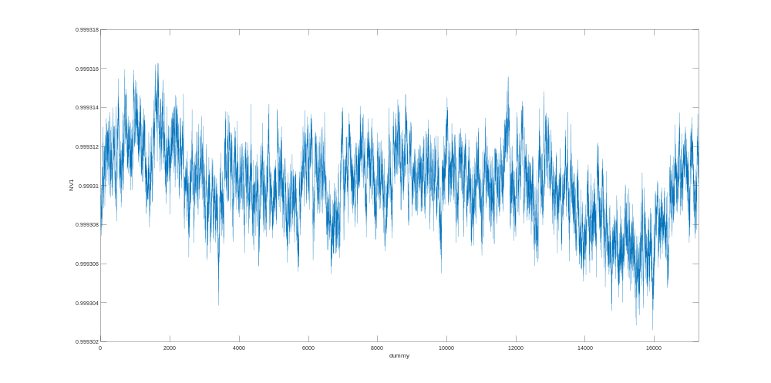
20220715_NUDAC_LongTerm_002.mat
7/17/2022 10:08 PM
NUDAC = 1
Start Time: 20220715 2205
End time: 20220717 2205
Range for NUDAC: 10V
Range for Keathley 2182: 1V
Slow Mode, Filter On
More Details:
-Middle of the Electronics Bench
-Nobody in the lab except Henry Bae

